Slide 1
Explorathon 2019
Using Computer Science
To Make Games

Slide 2



Women in Computer Science

Slide 3
Careers in Computer Science
Software Engineer
Web Application Developer
Mobile Application Developer
Video Game Developer
...and so much more!
Today we will show you what its like to develop a video game and write real code!

Slide 4
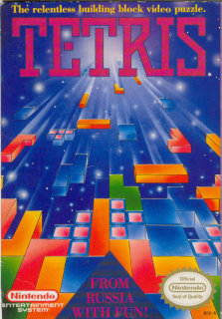
Our Inspiration
The game we will create today is based on the classic video game Tetris. We have changed the images, but the heart of Tetris remains.
We have also supplied a finished version of our game.

Slide 5
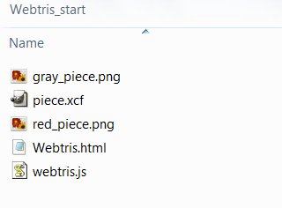
Open the Starter Project
Open up the file browser
Find the Webtris_start folder in the flash drive
The initial setup of the project comes with:
  Files for the game piece graphics
  An HTML file that draws our pieces, calls our code, and displays our game
  A JavaScript file that does all the work!

Slide 6
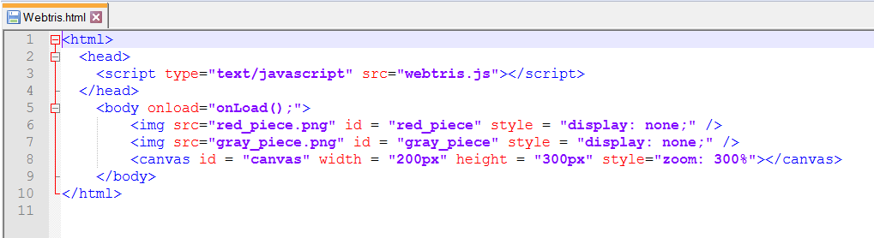
Our Simple HTML File
In the HTML file, the images are loaded in the body of the page, but they are hidden with “display:none”
The canvas element is what we draw our game on
A function named onLoad() is called on the body during the “onload” event.

Slide 7
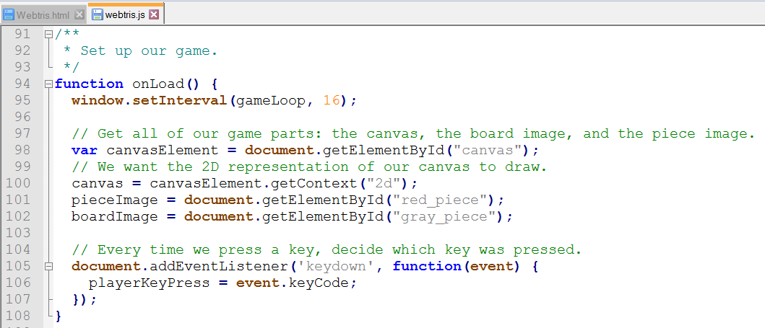
Our onLoad() Event
Open the
JavaScript file
If we scroll down
about halfway,
we can see our
onLoad() function
The onLoad() function first initializes our game loop
Then, it takes the canvas from the HTML file, and gets it ready for us to draw with it
The code listens for key presses, and records the unique key code
The gameLoop() function calls methods to handle input and draw the game

Slide 8
Let's Draw Something
Find the function at the bottom of the file called drawGame()
The first thing we are going to do is make a black background for our game
We will draw a black rectangle starting at (0, 0) with size 200px by 300px to fill the canvas
After we have written the code below in drawGame(), open the HTML file in the browser, you will see a black box.
function drawGame() {
canvas.fillStyle = "black";
canvas.fillRect(0, 0, 200, 300);
}

Slide 9
How to Draw an Image
function drawGame() {
canvas.fillStyle = "black";
canvas.fillRect(0, 0, 200, 300);
canvas.drawImage(pieceImage, 0, 0);
}
Underneath our black background code, we're going to draw the piece image (a red square)
Again, we want to draw this at the top left corner at (0, 0)
After we write this one line of code, we can refresh our HTML file in the browser

Slide 10
Drawing a Piece
The next step is to change the line we just wrote to draw a whole Webtris piece instead of just one square
We used an “array” to define the shape of our game piece (see the piece variable in webtris.js)
An array is one of the best ways to represent a 2D structure in code
It looks a lot like a mathematical matrix!

Slide 11
Arrays – a Quick Lesson
Our JavaScript file is filled with arrays because they're easy to use to store our game board and the piece shapes
When we want to step through our array, we use something called a “for loop”
We grab the first row, and the first column
Our next step is the next column on the same row, until we run out of columns
Then we move to the next row
var piece =
[[0, 1, 0],
[0, 1, 0],
[0, 1, 1]];
Column
Row

Slide 12
What Does draw2DArray() Do?
function draw2DArray(drawArray, xPos, yPos) {
for (var x = 0; x < drawArray[0].length; x++) {
for (var y = 0; y < drawArray.length; y++) {
var value = drawArray[y][x];
if (value > 0) {
var image;
image = pieceImage;
canvas.drawImage(image, (x + xPos) * 8, (y + yPos) * 8);
}
}
}
}
There are two “for loops” because we need to keep track of the row (x) and column (y)
When we find a 1 in our piece array, we can draw our single square
We multiply it by 8 because each square that makes up our piece is 8 pixels tall by 8 pixels wide
The xPos and yPos will tell the code where to draw this image on the board

Slide 13
Let’s Use draw2DArray()
Let’s change our code in drawGame() to the line below
Once we type this in, we can refresh our browser
function drawGame() {
canvas.fillStyle = "black";
canvas.fillRect(0, 0, 200, 300);
draw2DArray(piece, 0, 0);
}

Slide 14
Time to Draw the Walls
We want to update our draw2DArray() function to also draw a board piece
There are a few small changes we need to make:
  If we see a 1, we want to draw a piece image
  If we see a 2, we want to draw a board image
Make the updates in yellow below to the draw2DArray() function
function draw2DArray(drawArray, xPos, yPos) {
for (var x = 0; x < drawArray[0].length; x++) {
for (var y = 0; y < drawArray.length; y++) {
var value = drawArray[y][x];
if (value > 0) {
var image;
if (value == 1) {
image = pieceImage;
}
if (value == 2) {
image = boardImage;
}
canvas.drawImage(image, (x + xPos) * 8, (y + yPos) * 8);
}
}
}
}

Slide 15
Finish Drawing the Walls
function drawGame() {
canvas.fillStyle = "black";
canvas.fillRect(0, 0, 200, 300);
draw2DArray(board, 0, 0);
draw2DArray(piece, 0, 0);
}
Let’s update our drawGame() function
Add the board drawing line of code before the piece code
After adding the highlighted line, refresh the browser
Our pieces overlap our board, so let’s change the piece to sit at (0, 1);

Slide 16
Time to Move Our Pieces
In Tetris, we can move our pieces left and right, and even push it down
The next step is to listen to the key presses, and change our piece position based on that
Before we write our code, we need to review Cartesian coordinates

Slide 17
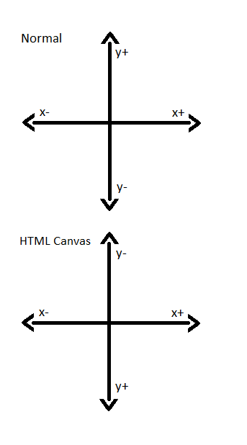
Coordinates - Quick Review
We can move our piece around on the screen according to x and y positions
We will store our x position with playerXIndex and our y position with playerYIndex
When we want our piece to go left, our playerXIndex variable decreases
Because positive y is downward, when we press down we want to increase our playerYIndex
We don't want our pieces to move up, so we won't write any code for that direction

Slide 18
Make Things Move
Go to the handleInput() function above the drawGame() function
We are going to update our piece coordinates based on which key is pressed
Our unique codes for the key presses are already saved for us
  KEY_PRESS_DOWN
  KEY_PRESS_RIGHT
  KEY_PRESS_LEFT
We will start with KEY_PRESS_DOWN first
function handleInput() {
if (playerKeyPress == KEY_PRESS_DOWN) {
playerYIndex = playerYIndex + 1;
}
}

Slide 19
Updating drawGame()
Back on the drawGame() function, we need to change the line that draws our image
Add our updated position to the x and y coordinates
After we've updated to the code below, it's time to test!
function drawGame() {
canvas.fillStyle = "black";
canvas.fillRect(0, 0, 200, 300);
draw2DArray(board, 0, 0);
draw2DArray(piece, playerXIndex, playerYIndex);
}

Slide 20
How Do We Fix That?
Our piece flew off the board!
We need to only move the piece 1 spot when a key is pressed
After we act on a key press, we can set the playerKeyPress variable to “false” to reset it
Add this highlighted line after our code that checks the key press
if (playerKeyPress == KEY_PRESS_DOWN) {
playerYIndex = playerYIndex + 1;
}
playerKeyPress = false;

Slide 21
Other Directions
We can copy our “if statement” from earlier
If the user presses the right key, our playerXIndex is going to increase
If the player presses the left key, our playerXIndex is going to decrease
After we have added the code below, we can test it in our browser
if (playerKeyPress == KEY_PRESS_DOWN) {
playerYIndex = playerYIndex + 1;
}
if (playerKeyPress == KEY_PRESS_RIGHT) {
playerXIndex = playerXIndex + 1;
}
if (playerKeyPress == KEY_PRESS_LEFT) {
playerXIndex = playerXIndex - 1;
}
playerKeyPress = false;

Slide 22
Inside the Wall
Our piece is going through the walls!
To fix that, we have to user a function to check for a “collision” to see if our wall is there
This function checks the player piece position against the position of the walls in our board variable
function checkCollision(playerXPosition, playerYPosition) {
for (var x = 0; x < piece[0].length; x ++) {
for (var y = 0; y < piece.length; y ++) {
var value = piece[y][x];
if (value > 0 && board[playerYPosition + y][playerXPosition + x] > 0) {
return true;
}
}
}
return false;
}

Slide 23
Handle Collision
We need to check for a collision inside of our handleInput() function using our new checkCollision() function
We tell checkCollision() to test the possible position (i.e. playerYIndex + 1)
If there is not a collision, then we can update our playerXIndex or playerYIndex
if (playerKeyPress == KEY_PRESS_DOWN) {
if (!checkCollision(playerXIndex, playerYIndex + 1)) {
playerYIndex = playerYIndex + 1;
}
}
if (playerKeyPress == KEY_PRESS_RIGHT) {
if (!checkCollision(playerXIndex + 1, playerYIndex)) {
playerXIndex = playerXIndex + 1;
}
}
if (playerKeyPress == KEY_PRESS_LEFT) {
if (!checkCollision(playerXIndex - 1, playerYIndex)) {
playerXIndex = playerXIndex - 1;
}
}

Slide 24
Make the Piece Stick
When a piece reaches the bottom, that piece has to stick there
That means, when you press down and there’s a collision, you’ve reached the bottom
When we add this highlighted code, we can see the piece becoming part of the board
if (playerKeyPress == KEY_PRESS_DOWN) {
if (!checkCollision(playerXIndex, playerYIndex + 1)) {
playerYIndex = playerYIndex + 1;
}
else {
applyPlayerPieceToBoard(playerXIndex, playerYIndex);
}
}

Slide 25
How applyPlayerPieceToBoard() Works
function applyPlayerPieceToBoard(playerXPosition, playerYPosition) {
for (var x = 0; x < piece[0].length; x++) {
for (var y = 0; y < piece.length; y++) {
var value = piece[y][x];
if (value > 0) {
board[playerYPosition + y][playerXPosition + x] = value;
}
}
}
}
We’ve already checked for a collision before this, so we know the piece can fit here
All we need to do is take the exact shape of our piece, by looking for the spots with 1’s and put them against the board
After this code runs, the piece is part of the board and can no longer be moved

Slide 26
Make a New Piece Appear
if (playerKeyPress == KEY_PRESS_DOWN) {
if (!checkCollision(playerXIndex, playerYIndex + 1)) {
playerYIndex = playerYIndex + 1;
}
else {
applyPlayerPieceToBoard(playerXIndex, playerYIndex);
playerXIndex = 5;
playerYIndex = 0;
}
}
We can put a new piece at the top of our board by zeroing out the x and y index
We can make our piece centered in the board like the real game by making the x index equal to 5

Slide 27
Trigger a Game Over
In Tetris, when the stack of pieces enters the off-limits zone, the game is over
Our game over zone is filled with -1’s
A game over will only happen when the piece triggers a collision while going down, so we will update those lines of code

Slide 28
What Does checkGameOver() Do?
This check is a lot like the check collision check, but with an extra step
Since we already checked for a collision, we know before we got here that we can’t move further down
If the piece overlaps a space on the board with a -1, we know that it’s a game over
function checkGameOver(playerXPosition, playerYPosition) {
for (var x = 0; x < piece[0].length; x++) {
for (var y = 0; y < piece.length; y++) {
var value = piece[y][x];
if (value > 0 && board[playerYPosition + y][playerXPosition + x] == -1) {
gameOver = true;
}
}
}
}

Slide 29
Add Our Game Over Check
if (playerKeyPress == KEY_PRESS_DOWN) {
if (!checkCollision(playerXIndex, playerYIndex + 1)) {
playerYIndex = playerYIndex + 1;
}
else {
checkGameOver(playerXIndex, playerYIndex);
if (gameOver) {
return;
}
applyPlayerPieceToBoard(playerXIndex, playerYIndex);
playerXIndex = 5;
playerYIndex = 0;
}
}
While we’re checking our collisions when pressing down, we can check for a game over before applying any pieces
Our checkGameOver() function will set the value of the gameOver variable, and we can check that later to see if we’ve reached that state

Slide 30
We Need to Show Game Over
We need to update our drawGame() function to show some menacing game over text
if (gameOver) {
canvas.fillStyle = "red";
canvas.font = "30px Arial";
canvas.fillText("GAME OVER", 10, 150);
}

Slide 31
Steps to Finish Your Game
Create the other piece shapes
Make the pieces appear randomly
Each time a line is formed, destroy it! After 10 lines have been removed, speed up the game
Display each piece with a count of how many were generated
Create a score board and keep track of the score
Make the pieces fall smoothly
Please keep an eye on https://github.com/originalgrego/Webtris for additions to this tutorial

Slide 32
Thank you!
Included on your flash drive are the following programs
  Notepad++ – A text editor with syntax highlighting, good for writing code
  Game Maker – A free to evaluate game engine (and 2015’s project/slides!)
  Gimp – A free and open source image editor
  Audacity – A free sound editing program
  BFXR – A free sound effect synthesizer
  Reaper – A digital audio workstation program providing convenient licensing
  Blender – A free and open source 3d modeling tool
  Tiled – A free and open source Tile Map editing tool, used for creating complex levels
Please visit https://github.com/originalgrego/Webtris for future updates to this project or to help in its development. Webtris is a GPL'd open source project that anyone can contribute to!
We hope you enjoyed Webtris!

